Slide 1

Bringing People into AR
Huynh Bao Trung Nguyen, Andreas Stiller, Luke Gavin

Slide 2
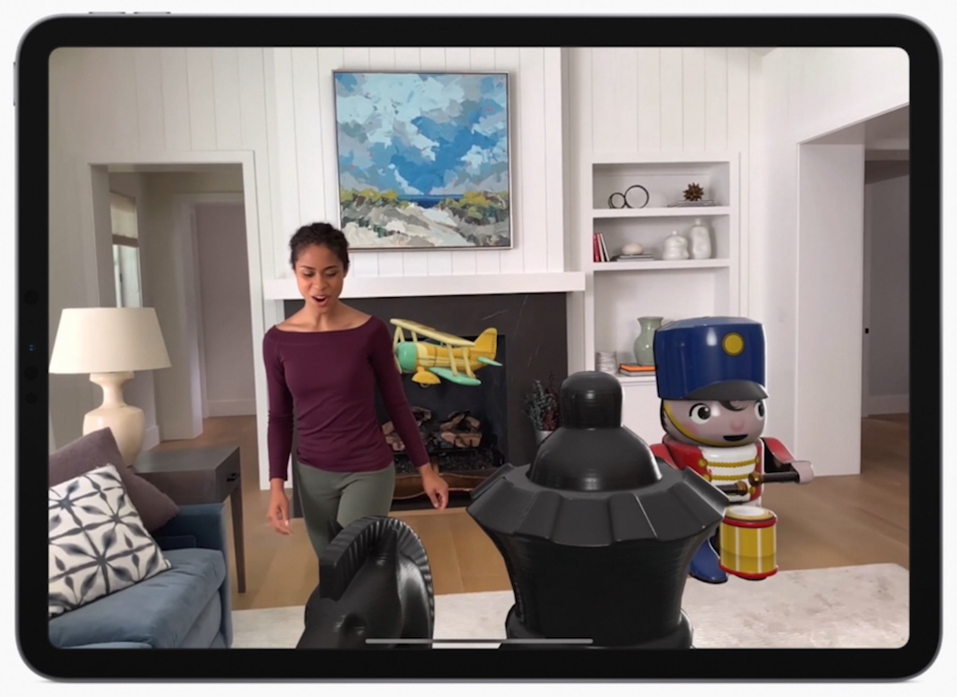
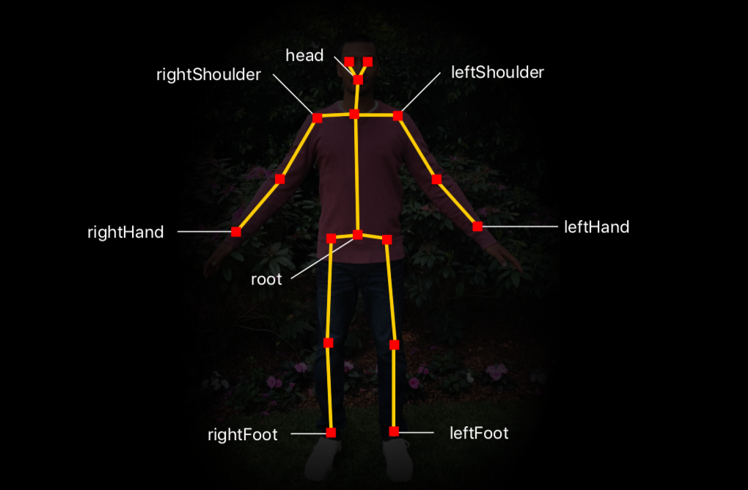
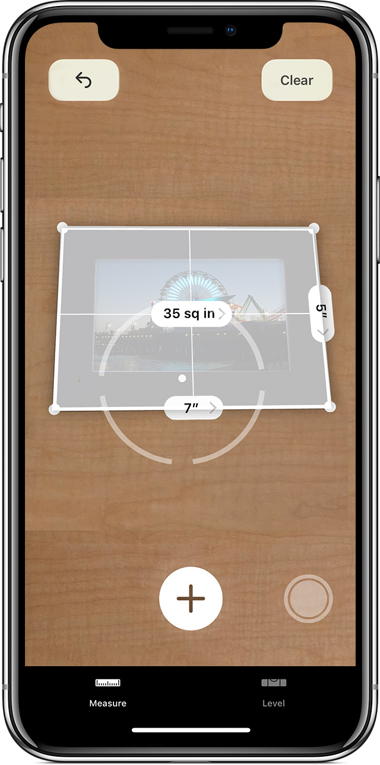
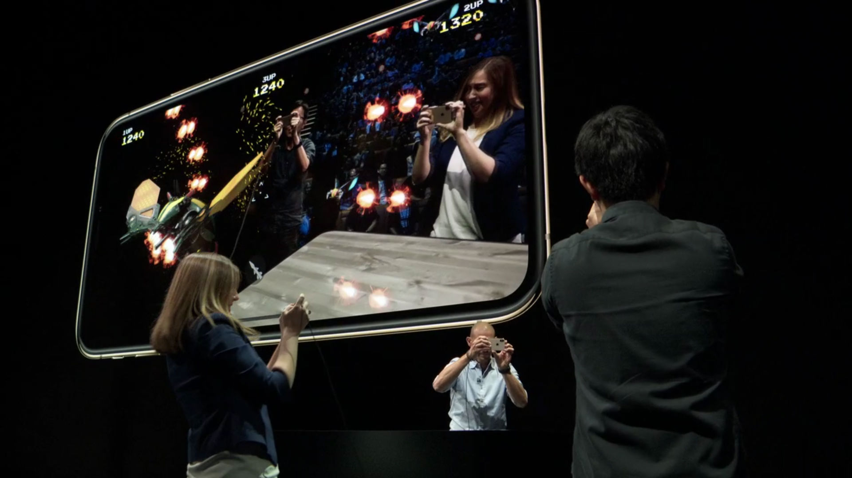
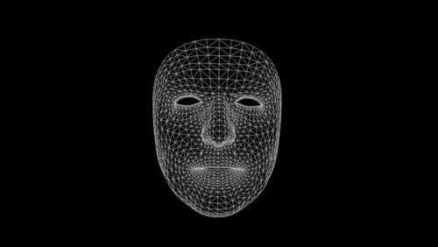
ARKit

Slide 3
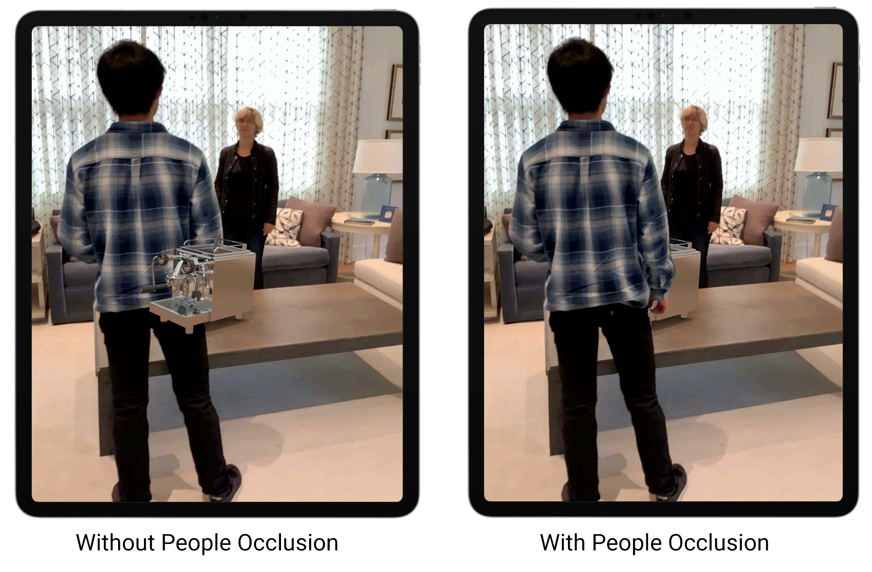
People Occlusion
Depth-ordering problem

Slide 4
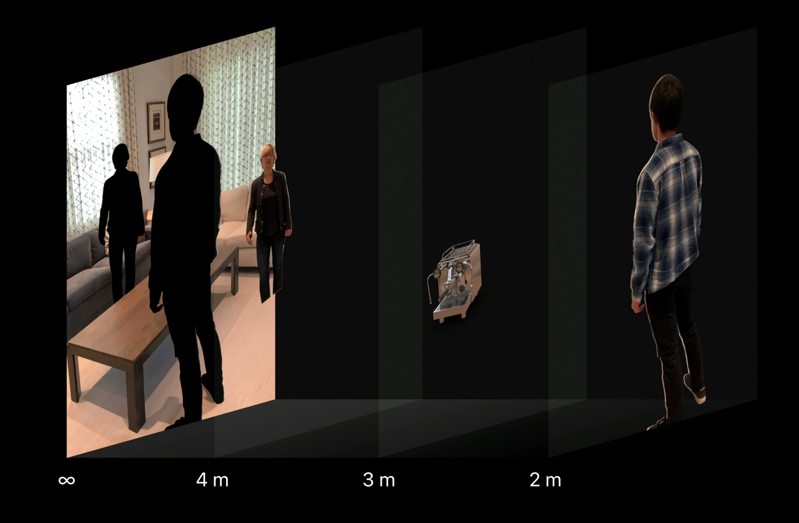
3

Slide 5
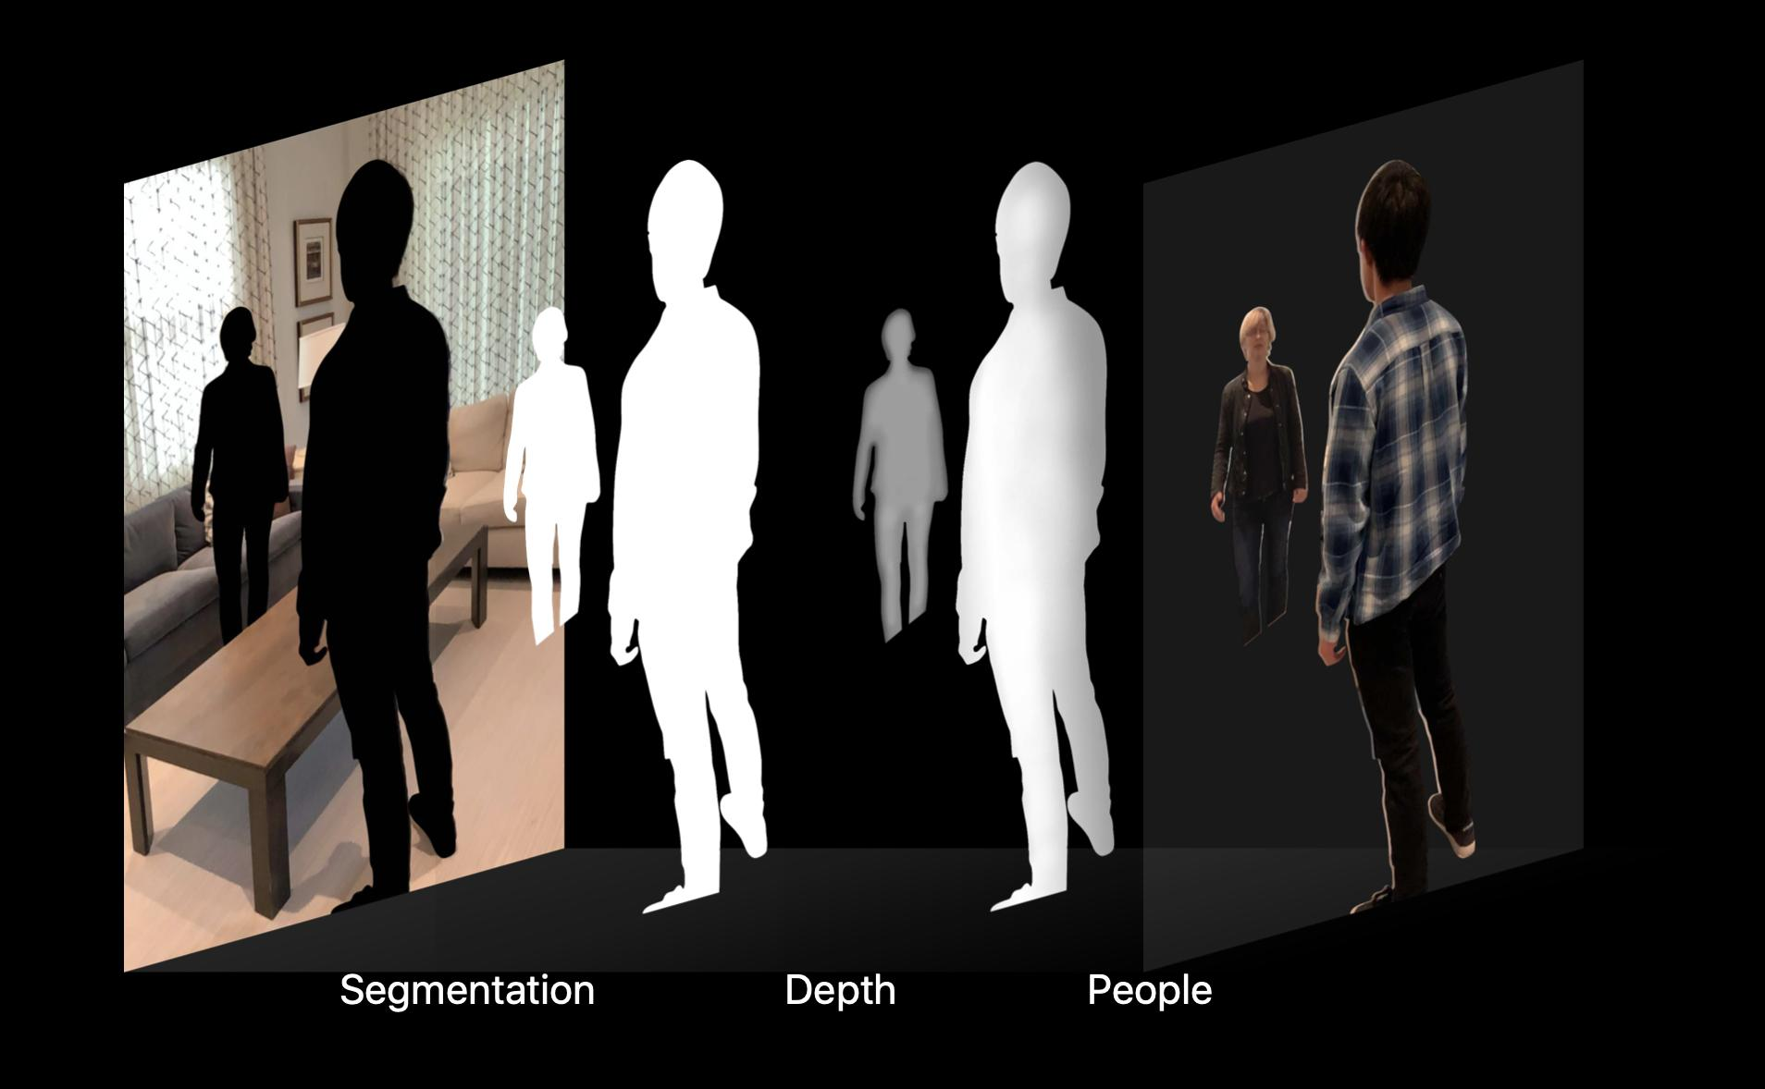

Slide 6


Matting Process

Slide 7

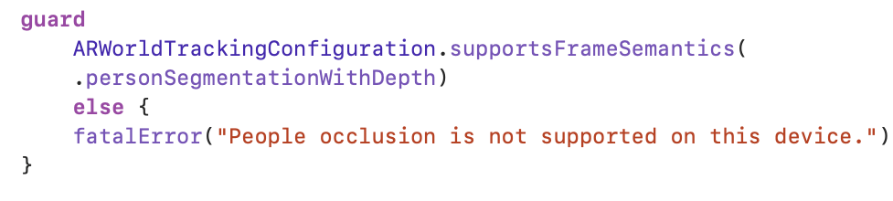


People Occlusion in ARKit
Verify Device Support for People Occlusion
Enable People Occlusion

Slide 8
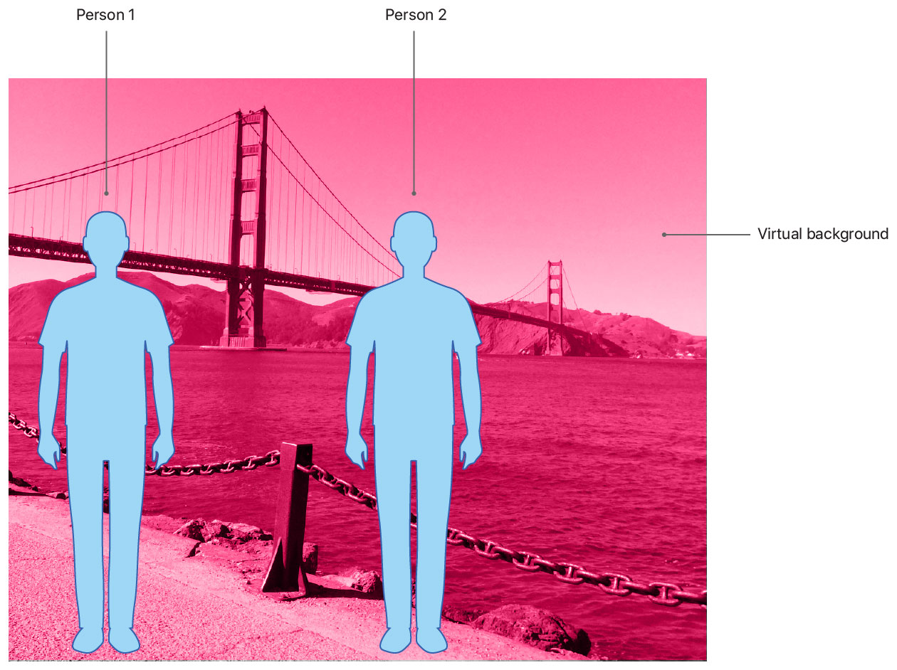
Disable People Occlusion
Always occlude persons:
personSegmentation
Occlude persons depending on depth:
personSegmentationWithDepth

Slide 9


SceneKit
Metal

Slide 10
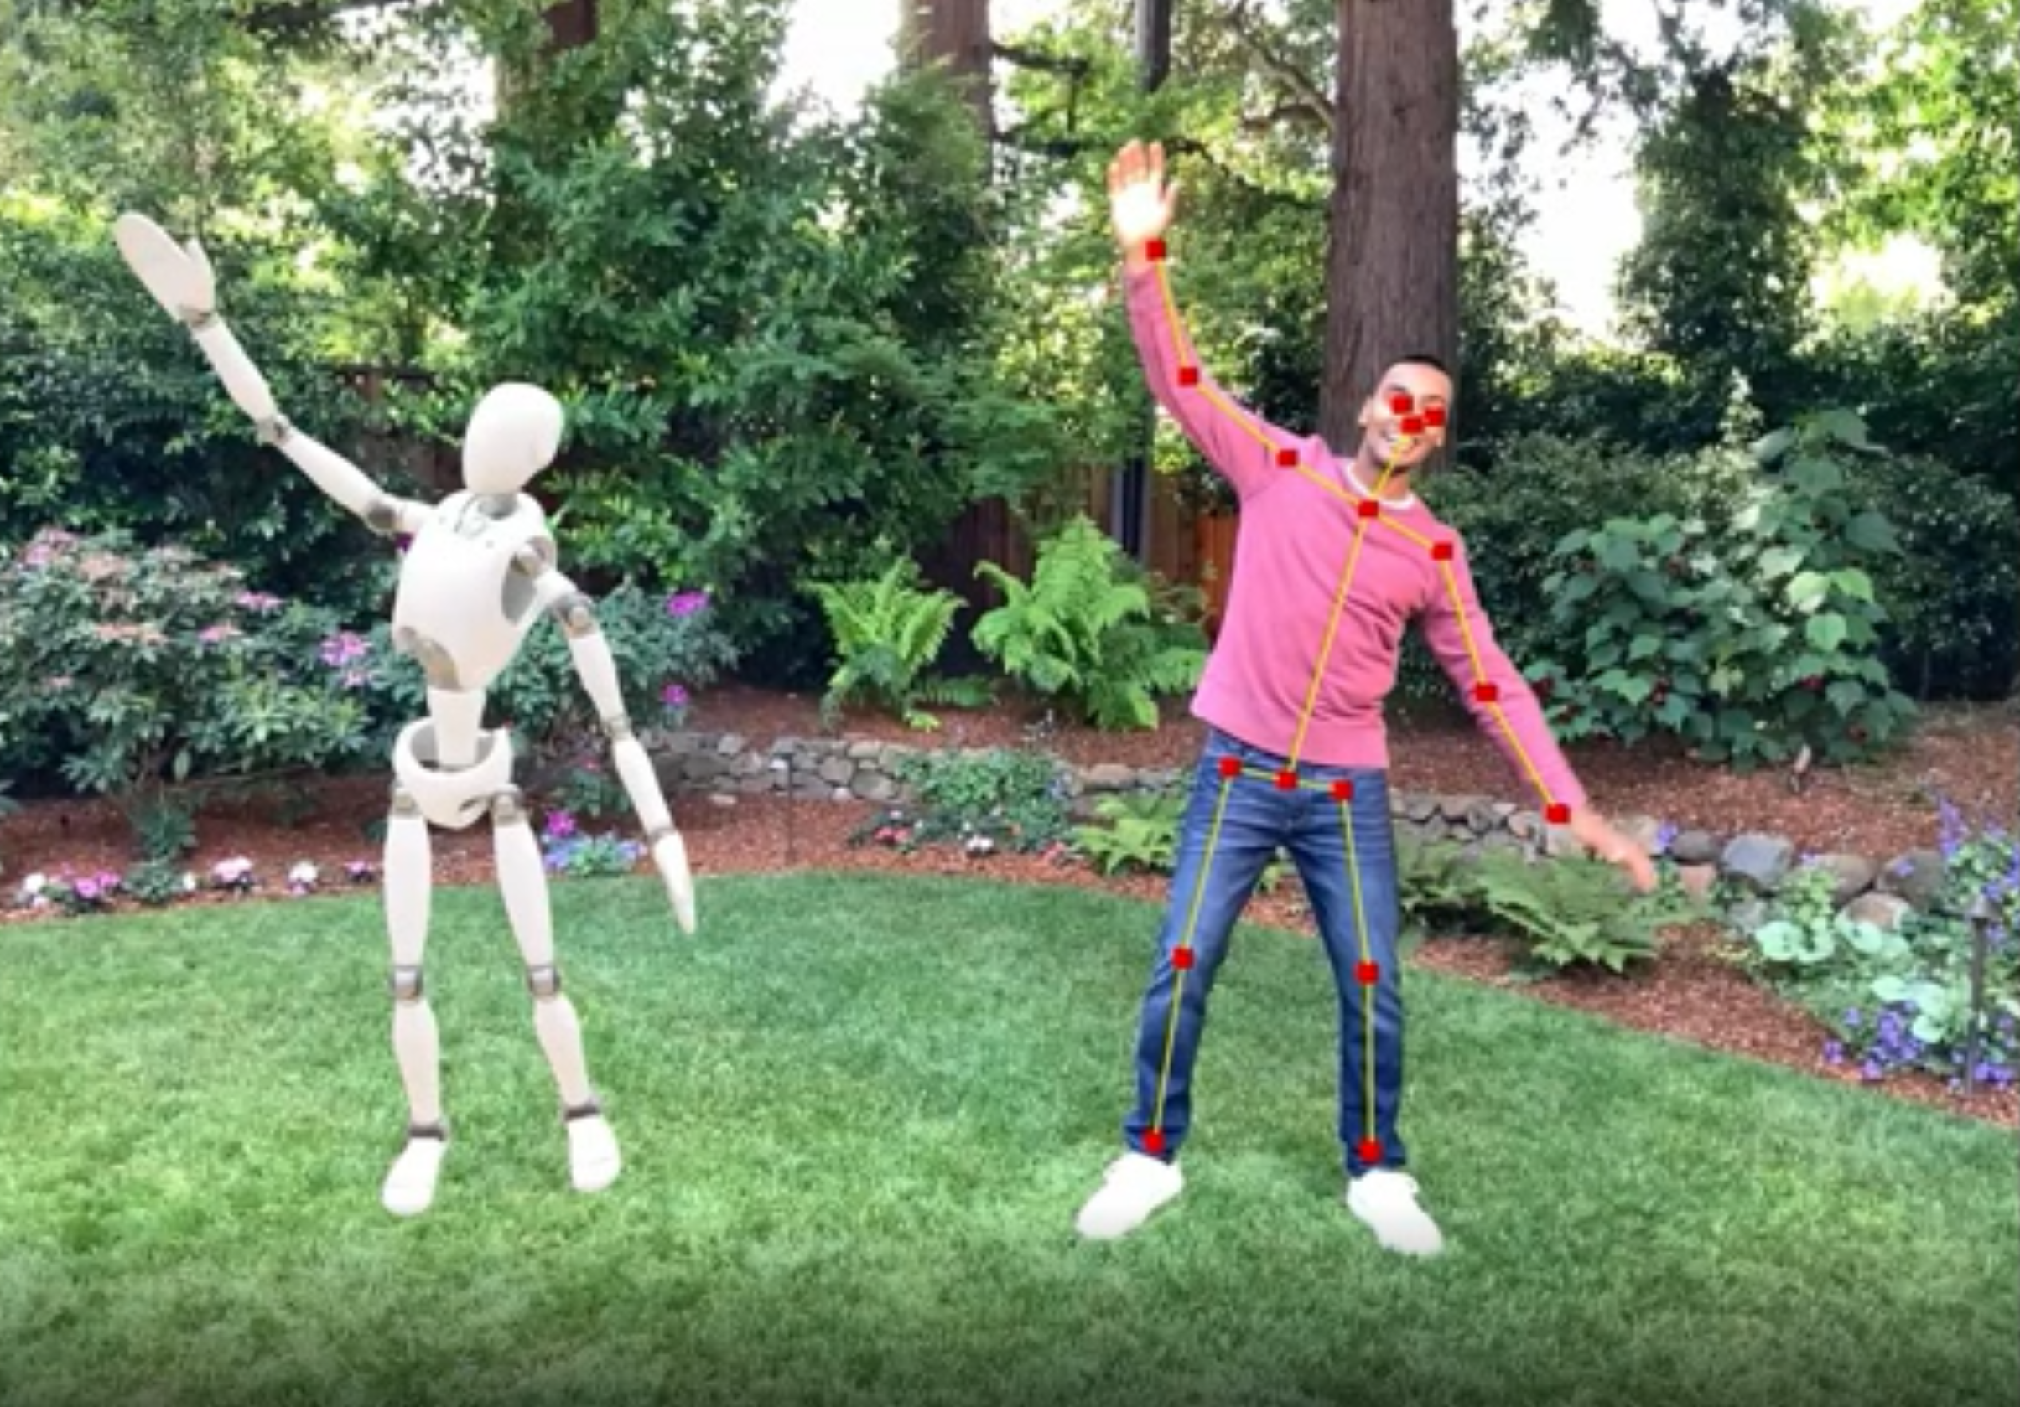
Body
Tracking

Slide 11
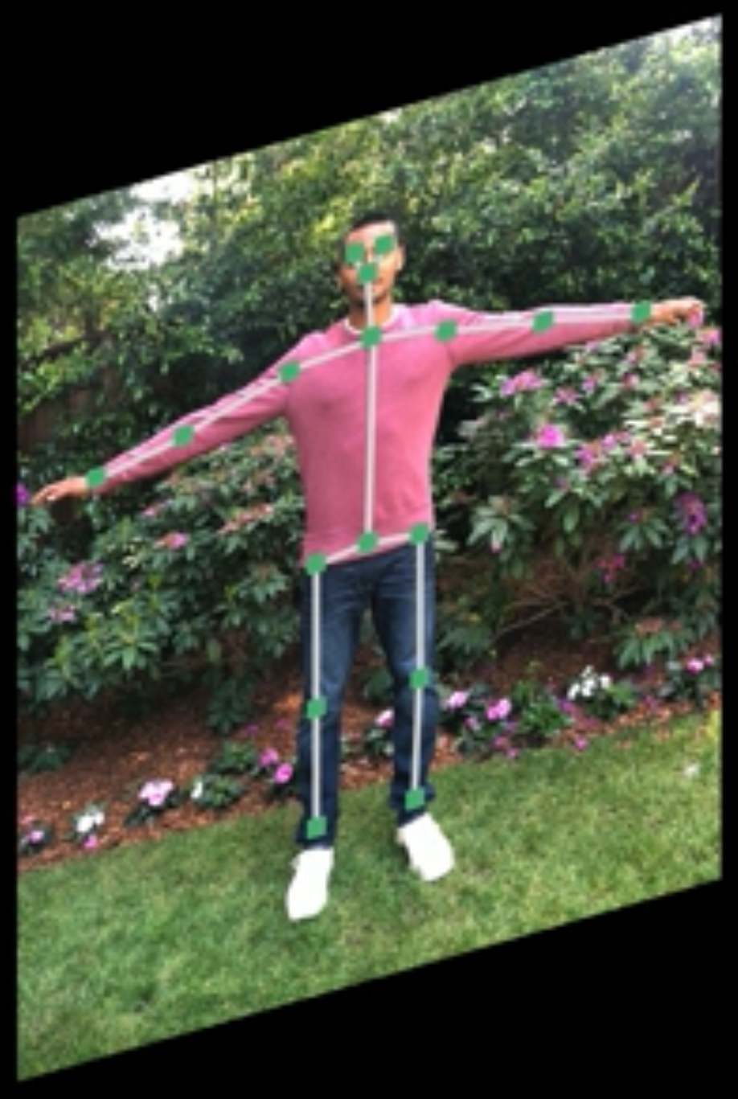
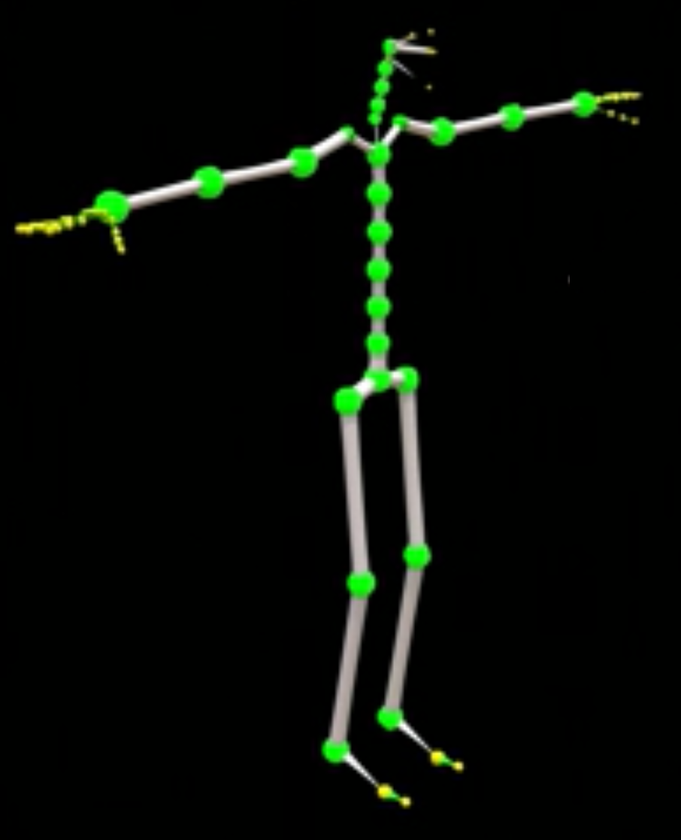
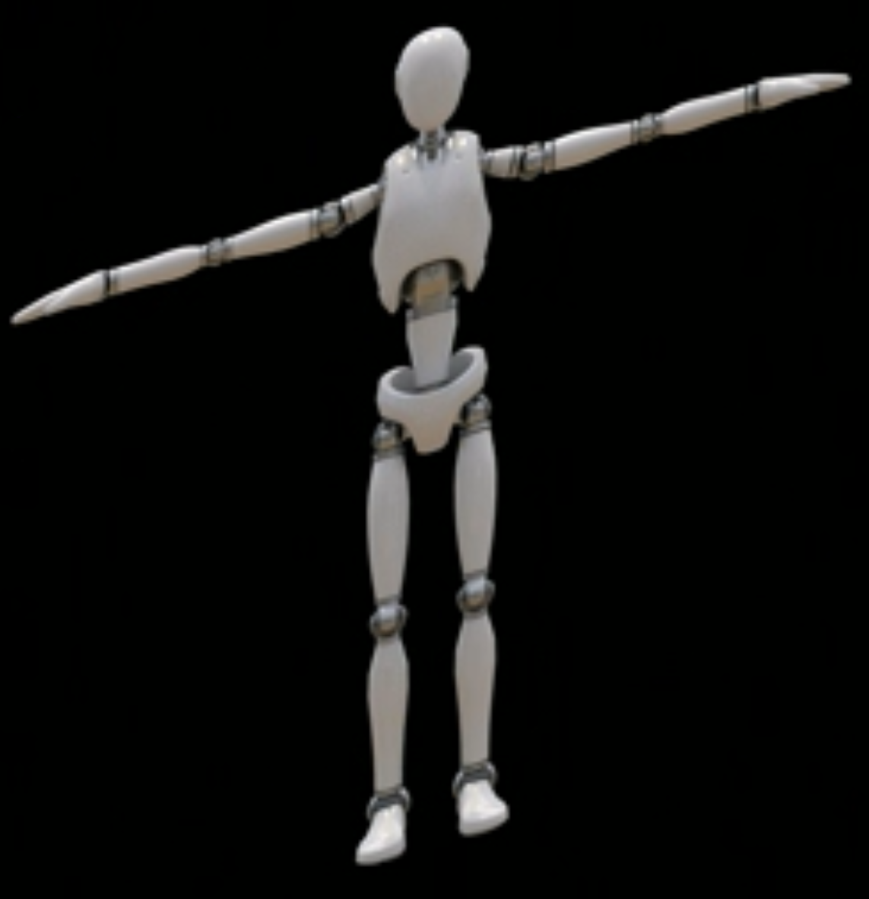

Slide 12
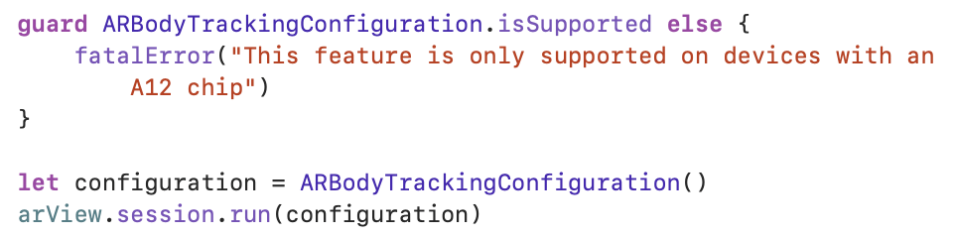
Motion Capture in RealityKit
Verify Device Support for Body Tracking

Slide 13
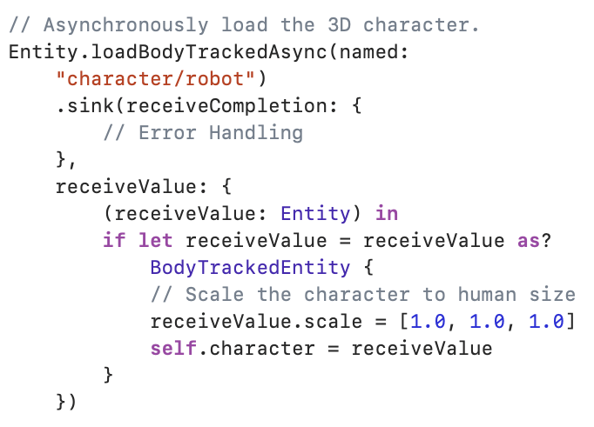
Load Rigged Mesh and Tracked Person

Slide 14

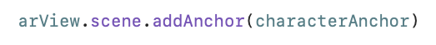
Get location where you want to put your character
Add the character to that location

Slide 15
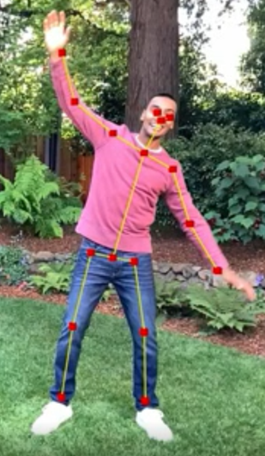
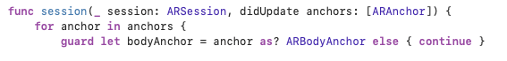
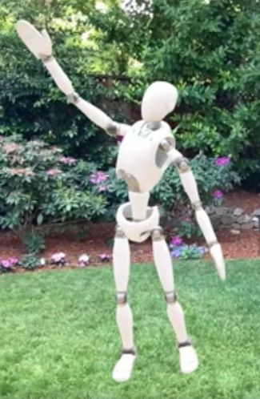
ARSessionDelegate to get ARBodyAnchor
BodyTrackedEntity

Slide 16
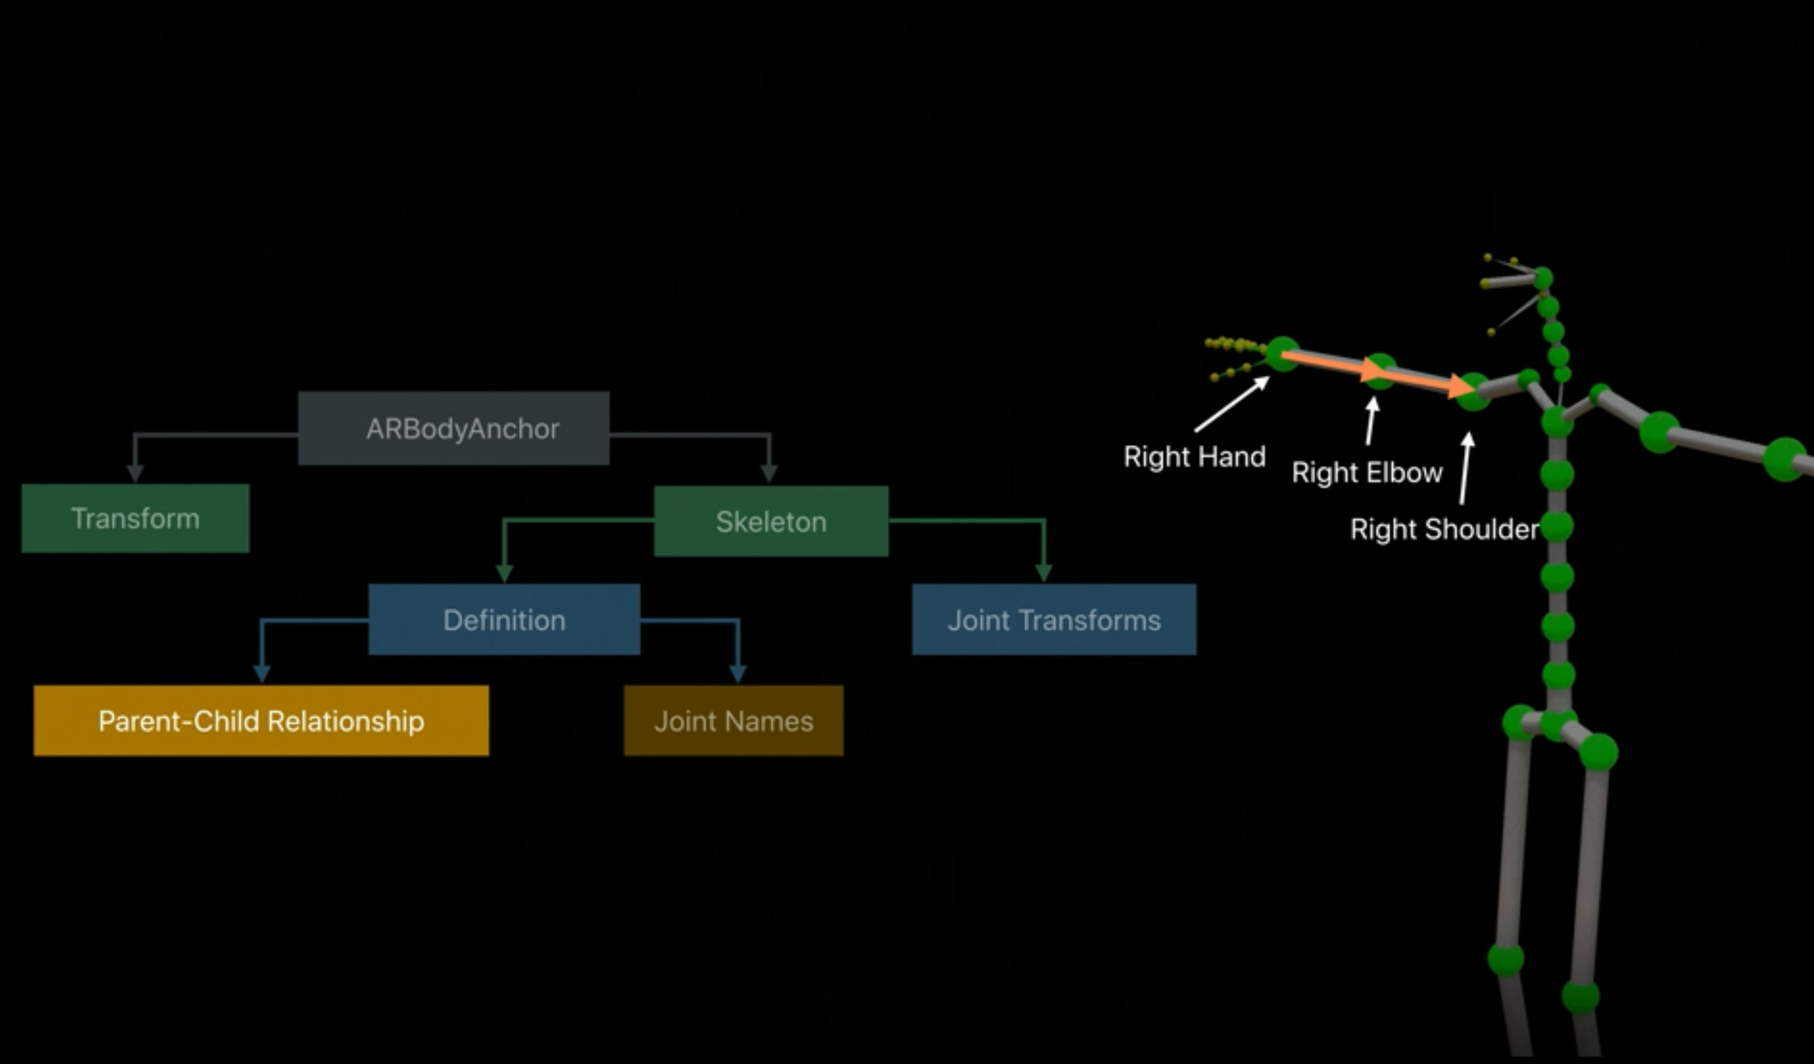

Slide 17
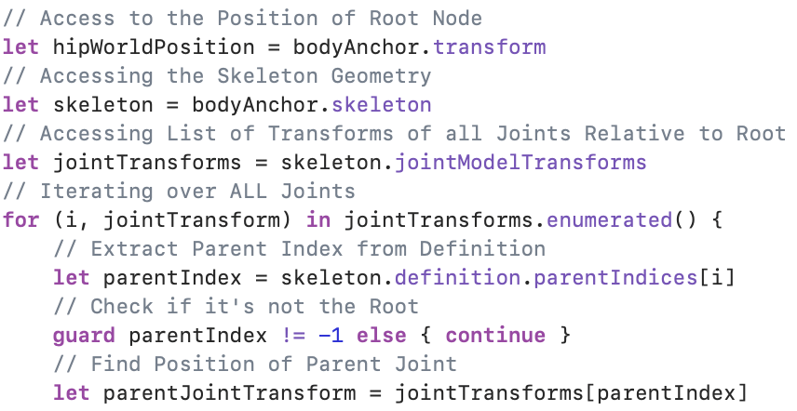
Extracting Data from 3D Skeleton

Slide 18
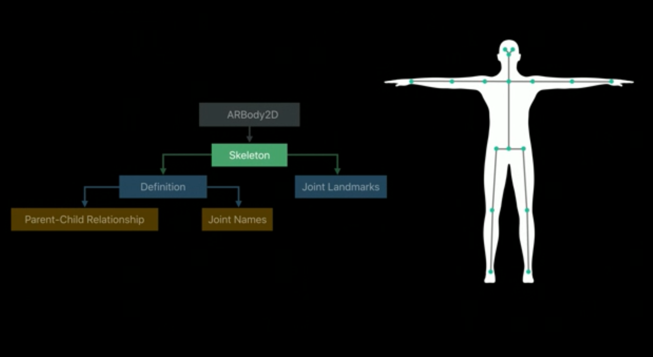

Slide 19
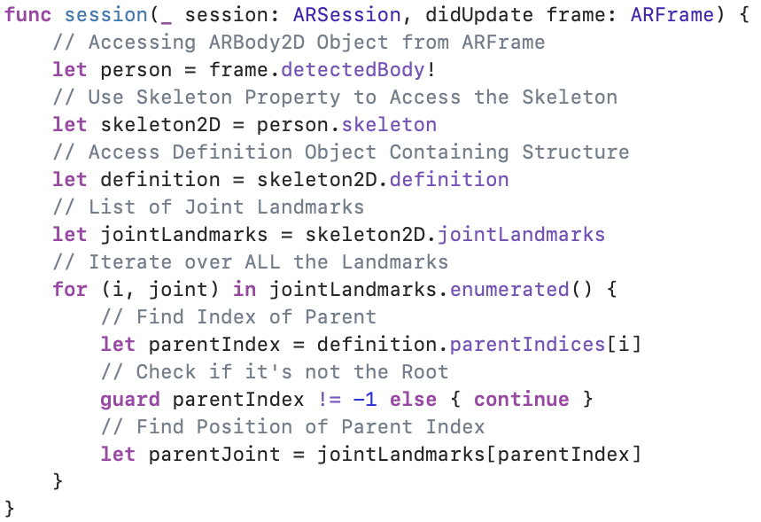
Extracting Data from 2D Skeleton

Slide 20
Demo

Slide 21
Thank you for your attention
Any Questions?

